Slide 1
Lead Management Process
June 2022

Slide 2
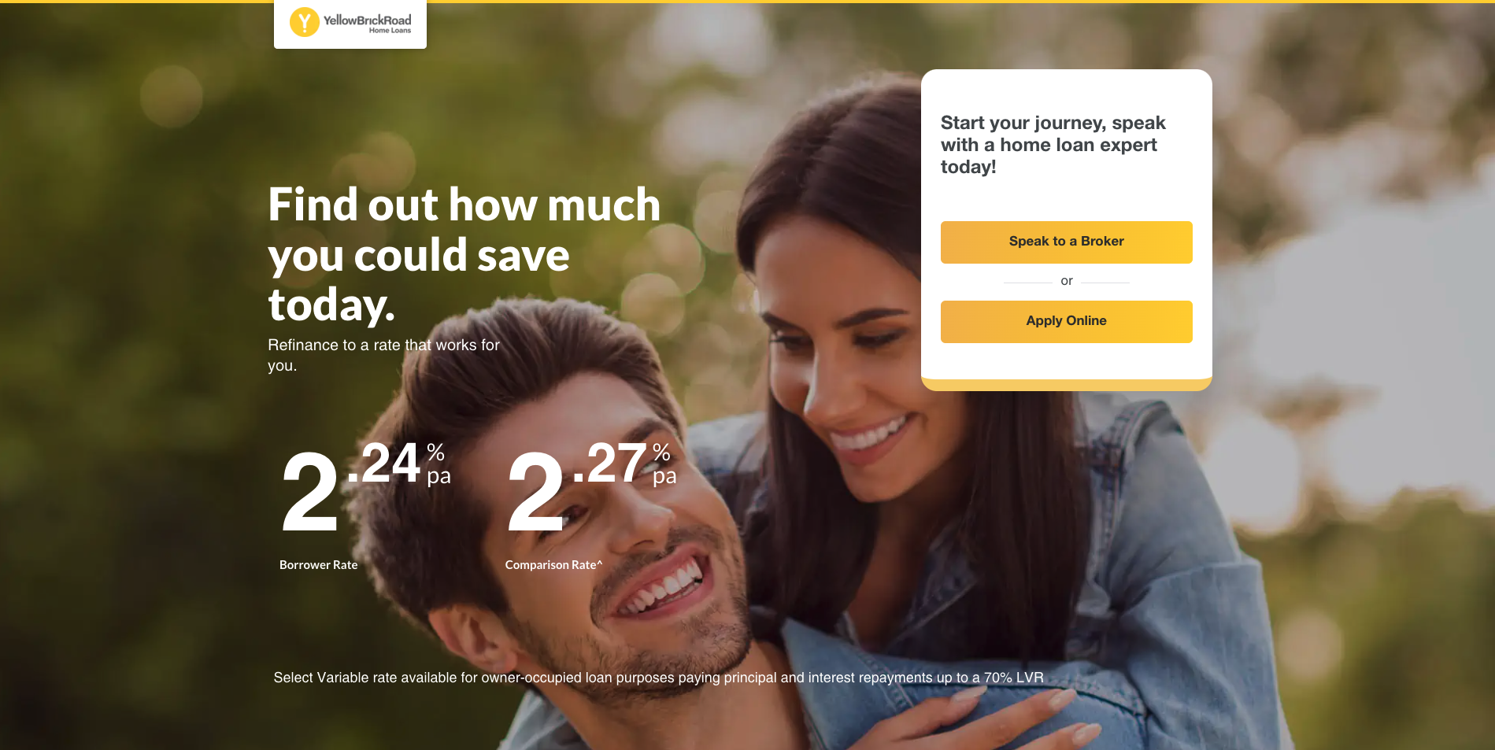
Customers now have four avenues to apply for a home loan:
ybr.com.au; OR
yhomeloans.com.au; OR
the call centre; OR
Click to call option - Customer connects with broker direct through 1800 number or clicking through on website

Slide 3
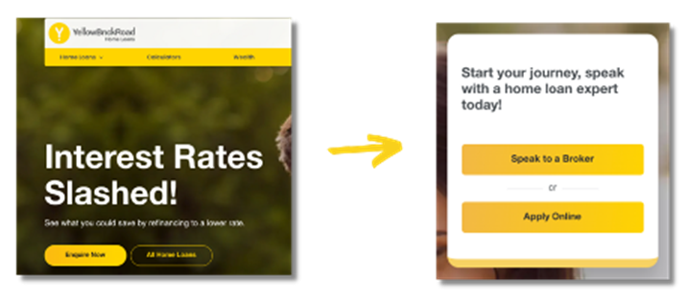
Ybr.com.au Process
When a new customer visits ybr.com.au and wishes to speak to a broker, they are presented with two options:
Speak to a broker, or commence lead verification process;
OR
Apply online – The customer will begin the YHomeloans process

Slide 4
Lead Verification Process:
This is an opt-in/opt-out process that is available to you. If you opt into lead verification, our Lead Assistants will receive every lead first, and make attempts to contact the prospective customer, within the time frames above.
All of their contact attempts will be entered into Ynet for your knowledge. If you would like to change your Opt IN or Opt Out settings for this Lead Verification service, please contact your BDM.
Please speak to your BDM regarding the best option for your business re opt in / opt out

Slide 5
If you have opted-in to lead verification
The Lead Assistant will accept the lead on your behalf and attempt contact with the customer within 2 business hours (please note: Lead assistant means the BULA service confirms the lead, gathers accurate information, to prevent time wasting). All contact attempts and information gathered will also be entered into Ynet.

Slide 6
If you have opted-in to lead verification
The Lead Assistant will confirm the lead and retrieve accurate customer information. The Lead Assistant will contact the prospective customer within the below timeframe:
1
First contact within the first 2 business hours by phone call
Final attempt after 72 hours by phone call
2
Second attempt after 24 hours - an email or SMS will be sent
3

Slide 7
Lead Verification Outcomes
Once the lead is "verified" as genuine and ready to be assigned to the broker, it will drop into the "Leads" workflow, "New Lead" stage and it will be labelled "HO Verified Lead".
If the Lead Assistant has exhausted all contact attempts, the lead will be assigned to the broker and appear in the “Leads” workflow, “New Lead” stage, but this time labelled “HO Unverified Lead”. The contact attempts will be recorded in the file.
The broker will be required to pick it up and continue managing that customer enquiry, including keeping notes updated and moving it to the right stage/status.
The broker will now be required to take over management of the lead and decide whether they need to mark it “Lost” so that it drops off the workflow
Please note: You are required to nurture that lead by labelling the customer with one of the new YBR Customer labels to link them up to a marketing communications via ActivePipe.

Slide 8
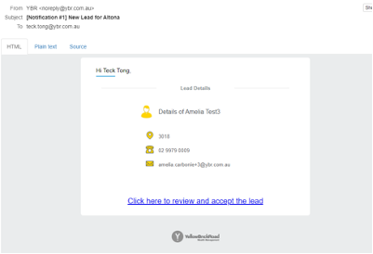
If you have opted-out of lead verification
You will receive your SMS / email notification of the new lead and you will have two business hours to accept the lead, otherwise the lead will be passed onto the next nearest broker.

Slide 9
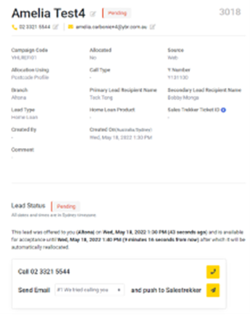
Lead Workflow
Once a lead is accepted within the required timeframe, it will drop into your Ynet org under the “Lead” workflow, "New Lead" stage and be labelled "HO Lead". You will be required to pick it up and continue managing that customer enquiry, including keeping notes updated and also moving it to the right stage/status.

Slide 10
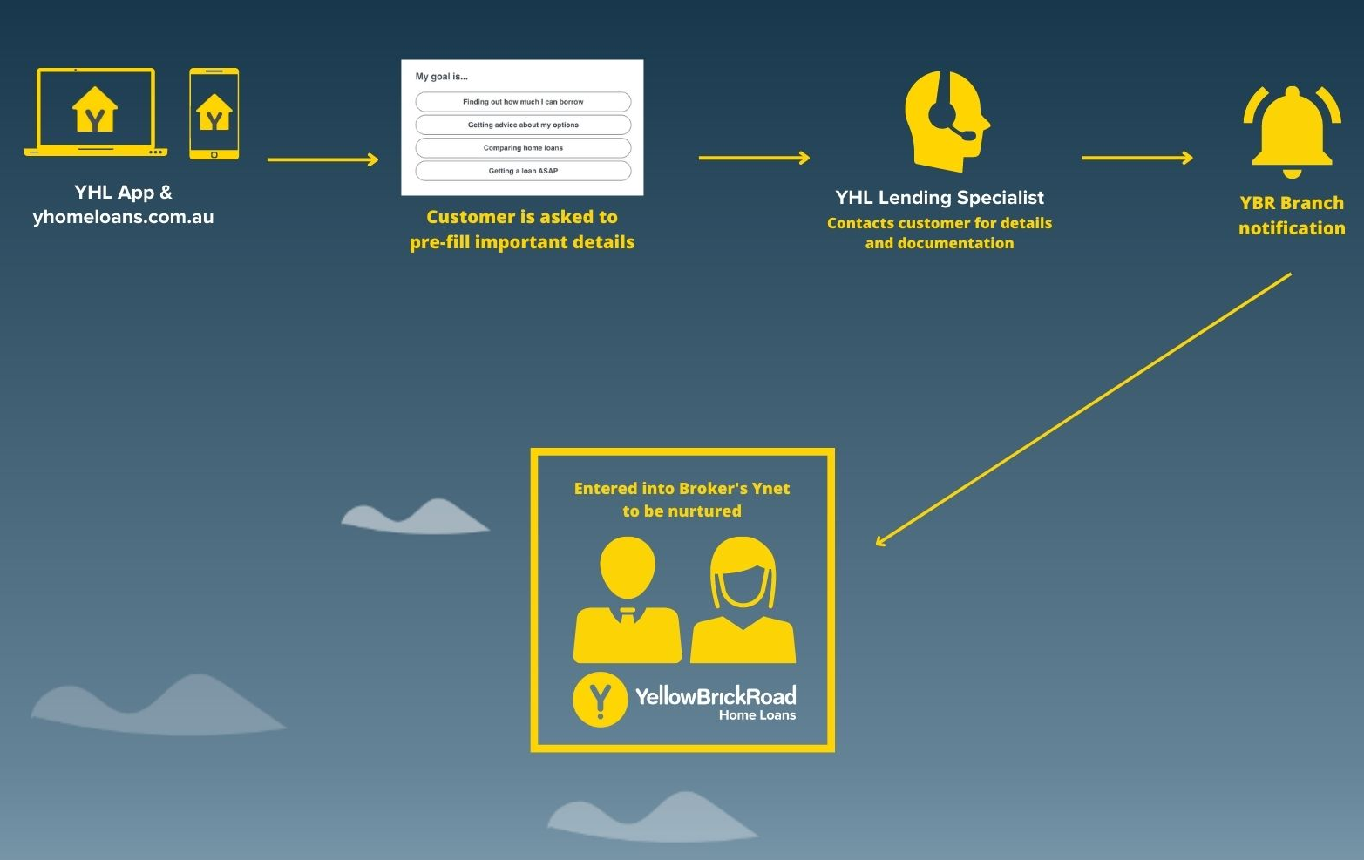

Slide 11
Y Home Loans Process
Both YHL representatives and Lead Assistants follow the same contact process and time frame.
YHL Contact time frame:
First contact within 2 business hours by phone call.
Second attempt after 24 hours - an email or SMS will be sent.
Final attempt after 72 hours by phone call.
If YHL Representative exhausts their attempts to contact the lead, it will be dropped into Ynet Org marked “YHL Cold Lead”. The broker will be required to take over management of the lead and decide whether they need to mark it “Lost” so that it drops out of the workflow.
*Don’t forget to nurture that lead ongoing by labelling the customer with one of the new YBR Customer labels. Link them up to a marketing campaign via ActivePipe.

Slide 12
Lead Labels
As outlined above, from June 1, all leads will have 1 of 5 labels within Ynet to help us analyse the quality of leads being provided. These new labels are:
1. HO YHL HOT Lead:
If the YHL representative has been able to get in contact with the customer and gather information and/or documentation from them.
2. HO YHL COLD Lead:
If the YHL representative has not been able to contact or get any information from the customer.
3. HO Verified lead (Verified by Lead Assistant):
If you have opted-in for lead verification (outlined below), the Lead Assistant will verify the lead and enter that information into Ynet.
4. HO Unverified Lead (Lead Assistant unable to verify the lead):
Your Lead Assistant has been unable to verify the lead after 72 hours and the lead is passed onto you regardless.
5. HO Lead (all other leads)
All other leads, whether that lead comes through web or the call centre.
For example if a lead comes through the call centre and you have opted out of the Lead Verification process, then this lead will be entered into your Ynet org as ‘HO Lead’.

